Slide 1
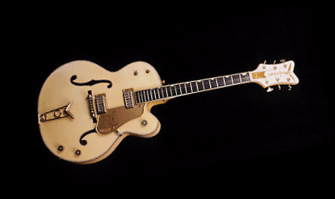
The Hollow Body and Semi-Hollow Body Guitar
Jeff Klegon

Slide 2
Background
Contains a sound box as well as pickups
Became popular in the 1950s
Used in many Genres: Blues, Jazz, Indie Rock
The sound box amplifies tone, but results in high-gain amplification
Meant to produces an acoustic guitar effect through an amplifier

Slide 3
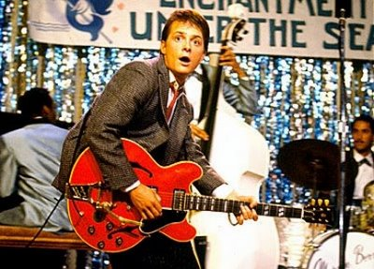
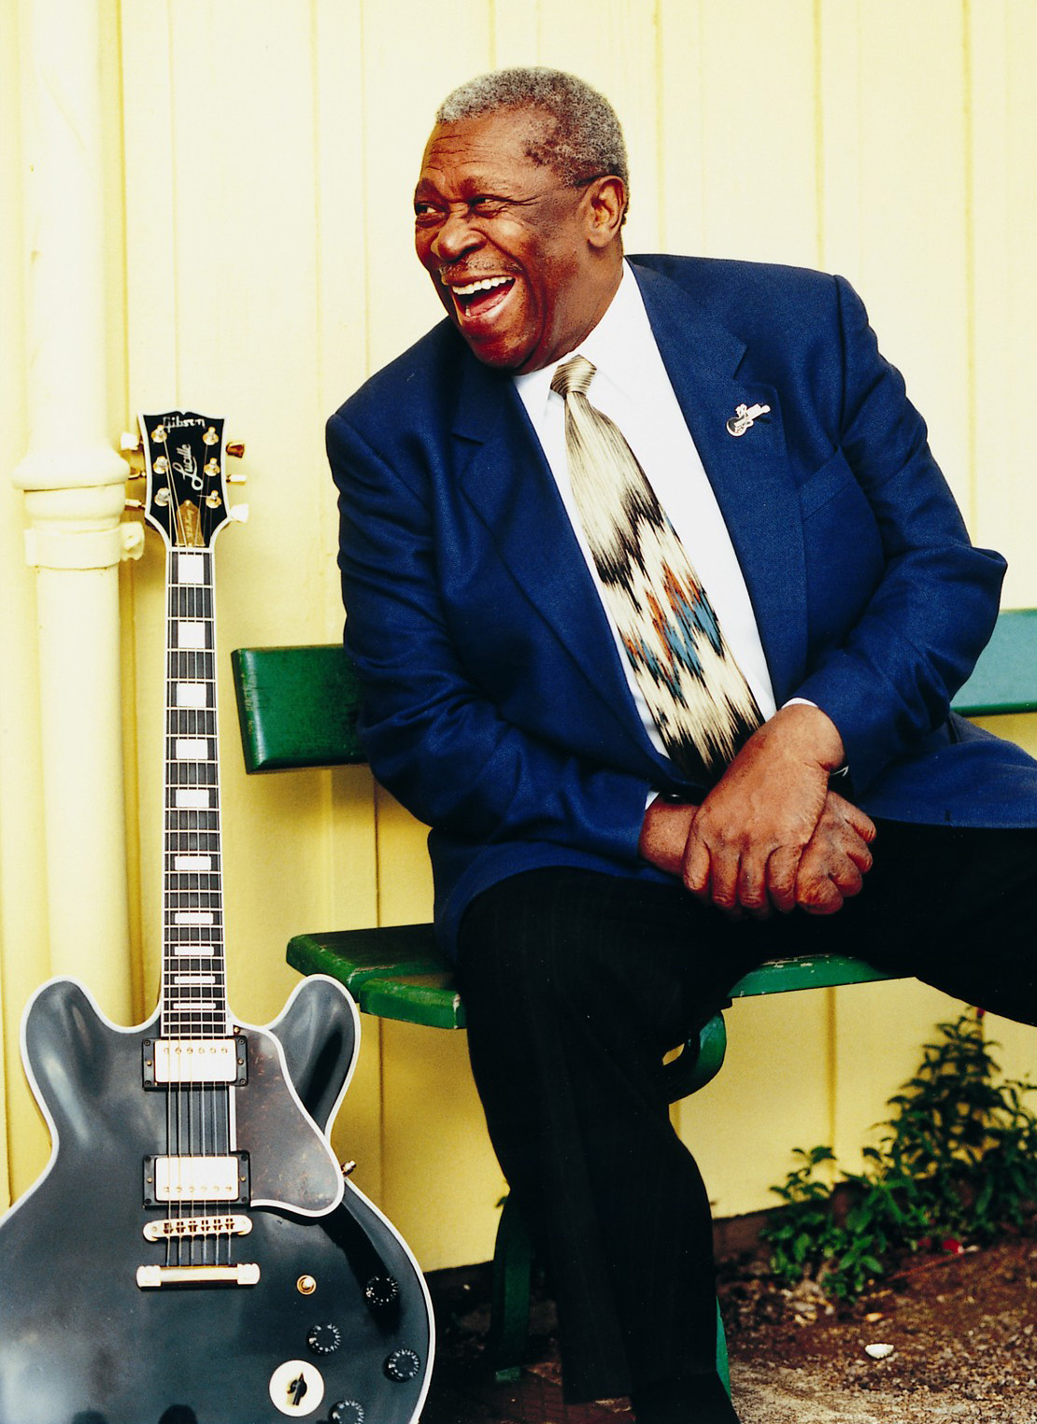
Popular Uses
Made famous by many
musicians and movies

Slide 4
Analysis
Dr. Russel from Kettering University
Performed a modal analysis on four different guitar body shapes
Hollow-body tested was a Gibson ES – 335
Strings set to their traditional keys with corresponding frequencies

Slide 5
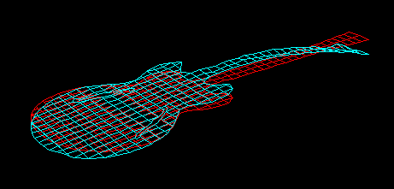
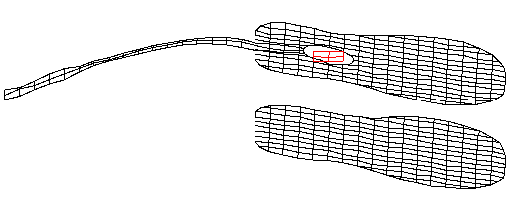
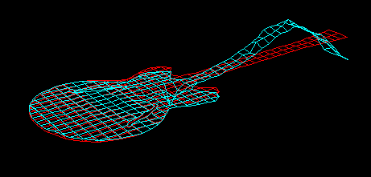
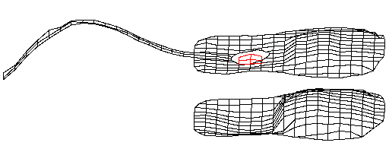
Bending Modal Analysis
First Mode – 59-82 Hz
Second Mode – 196-223 Hz

Slide 6
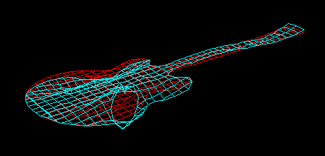
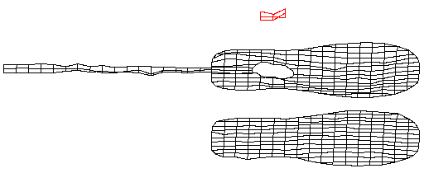
Breathing Modal Analysis
Occurs when the top and bottom plates vibrate when they are 180 degrees out of phase
Results in a great pressure changes within the cavity
The sound box can then simulate a similar effect to that of an acoustic guitar

Slide 7
Conclusions
With the sound box mellower fuller sound can be produced
A mid-range sound is produced
The hollow-body cavity causes flexibility and results in a reduction in higher frequencies
The resonance that can occur within the cavity can cause high gain amplification

Slide 8
Examples

Slide 9
References
http://www.productwiki.com/electric-guitars/article/legendary-guitar-heroes-and-their-guitars.html
http://www.kettering.edu/physics/drussell/guitars/
http://music.stackexchange.com/questions/2501/do-hollow-body-guitars-really-sound-more-mellow
http://en.wikipedia.org/wiki/Semi-acoustic_guitar

