Slide 1
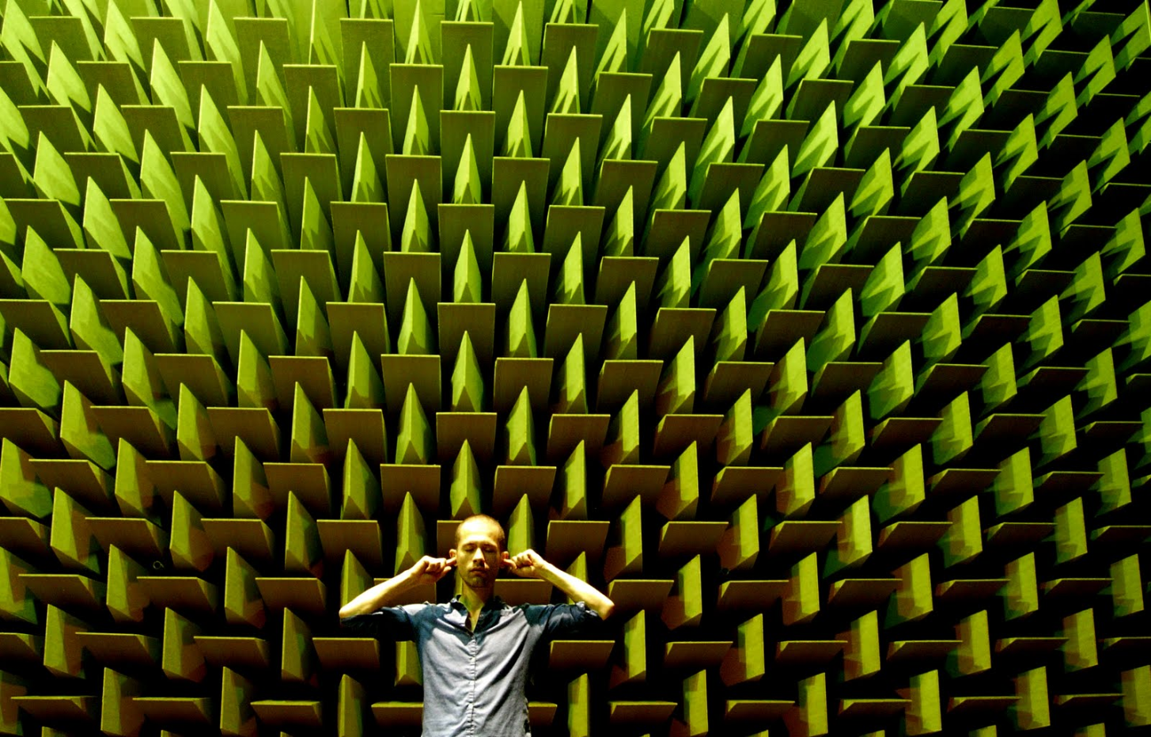
Anechoic Chambers

Slide 2
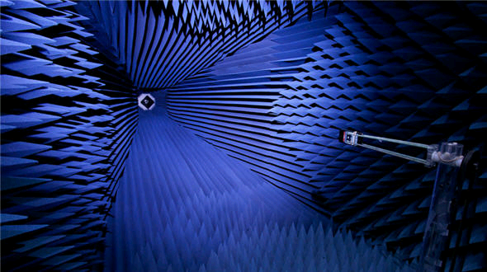
What is an Anechoic Chamber?
It’s all in the title:
“An-” prefix for “non”
“echoic” producing echoes
Room that is used to simulate an infinite (“free-field”) acoustic space
Absolutely no acoustic reflection back to the source

Slide 3
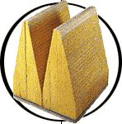
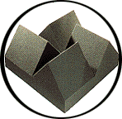
How does it work?
Absorbers cover the interior of the chamber
Reflect sound away from source using pyramid/wedge shapes
Stealth fighters use a similar principle to go undetected by radar
Absorb sound with fiber glass/foam composition
Length of absorber decreases with increase in frequency
Acoustic tests: multiple feet
RF tests: a few inches
Reflection and transmission of waves
Fiber Glass Absorber
Foam Absorber

Slide 4
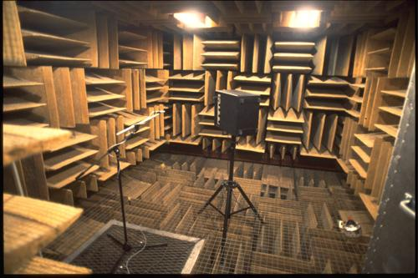
Fully-Anechoic Chamber
Walls, ceiling and floor are covered; wire mesh over
floor allows testers to set up tests easily

Slide 5
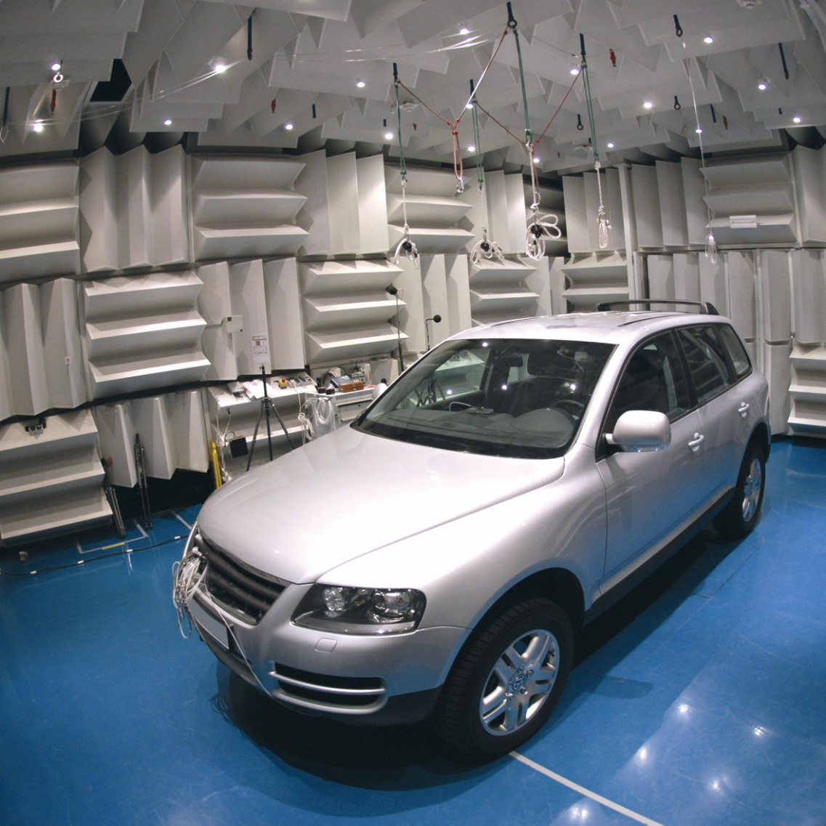
Semi-Anechoic Chamber
Have a solid floor to allow testing of cars, washing machines, etc.

Slide 6
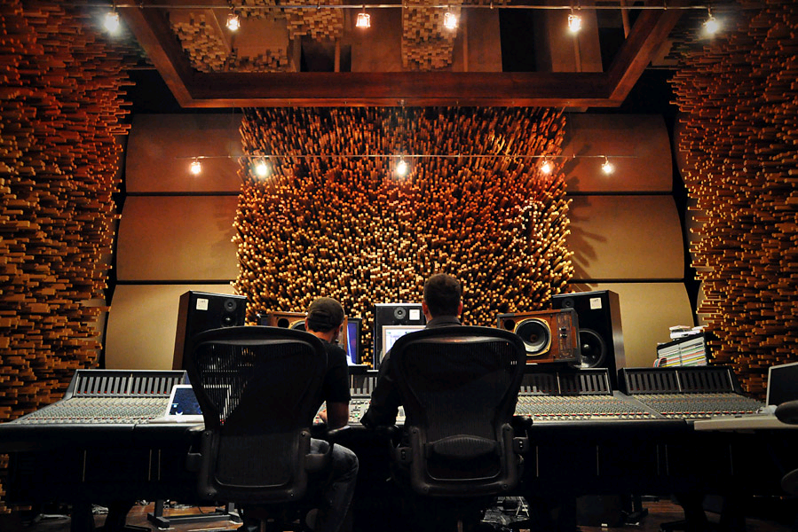
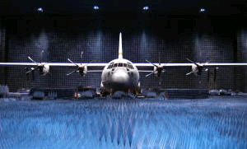
What is it used for?
Recording music
Semi-anechoic chambers eliminate unwanted echoes and noise in high-quality recording
Product testing and research
Hearing-aids
Vehicle noise levels
Appliance noise levels
Transfer functions of speakers
RF equipment

Slide 7
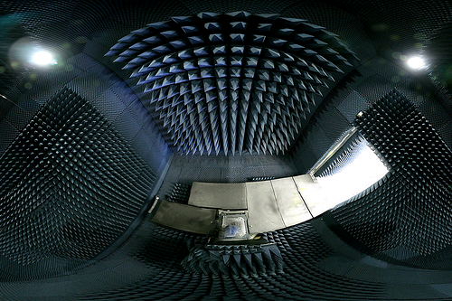
Questions?

Slide 8
References:
Wikipedia: "Anechoic Chamber"
"The Quietest Room in the World"
Wikipedia: "Radar-absorbent material"

